Slide 1
THE ORGANIZATIONAL CONTEXT
Chapter 2
Copyright ©2016 Pearson Education, Inc.

Slide 2
CHAPTER 2
LEARNING OBJECTIVES
After completing this chapter, you should be able to:
Understand how effective project management contributes to achieving strategic objectives.
Recognize three components of the corporate strategy model: formulation, implementation, and evaluation.
See the importance of identifying critical project stakeholders and managing them within the context of project development.
Recognize the strengths and weaknesses of three basic forms of organizational structure and their implications for managing projects.
Copyright ©2016 Pearson Education, Inc.
2-<number>

Slide 3
CHAPTER 2
LEARNING OBJECTIVES
After completing this chapter, you should be able to:
Understand how companies can change their structure into a “heavyweight project organization” structure to facilitate effective project management practices.
Identify the characteristics of three forms of project management office (PMO).
Understand key concepts of corporate culture and how cultures are formed.
Recognize the positive effects of a supportive organizational culture on project management practices versus those of a culture that works against project management.
Copyright ©2016 Pearson Education, Inc.
2-<number>

Slide 4
PMBOK CORE CONCEPTS
Project Management Body of Knowledge (PMBoK) covered in this chapter includes:
Project Procurement Management (PMBoK 12)
Identify Stakeholders (PMBoK 13.1)
Plan Stakeholder Management (PMBoK 13.2)
Manage Stakeholder Engagement (PMBoK 13.3)
Organizational Influences on Project Management (PMBoK 2.1)
Organizational Structures (PMBoK 2.1.3)
Organizational Cultures and Styles (PMBoK 2.1.1)
Enterprise Environmental Factors (PMBoK 2.1.5)
Copyright ©2016 Pearson Education, Inc.
2-<number>

Slide 5
INTRODUCTION
Within any organization, for successful project management, the organization setting matters—
  Its culture, its structure, and its strategy each play an integral part, and together they create the environment in which a project will flourish or founder.
  For example, a project’s connection to your organization’s overall strategy, the care with which you staff the team, and the goals you set for the project can be critical.
Copyright ©2016 Pearson Education, Inc.
2-5

Slide 6
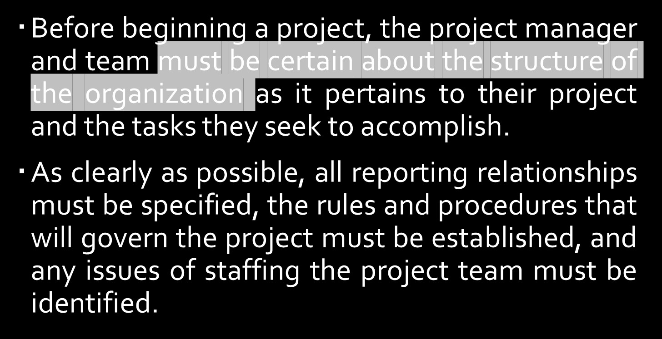
INTRODUCTION
Copyright ©2016 Pearson Education, Inc.
2-5

Slide 7
INTRODUCTION
For example: Prior to the start of Operation Desert Storm in 1991, the U.S. and allied countries devoted an enormous amount of time and effort to developing a working relationship among all coalition members, ensuring that:
  each group was given its assignments,
  understood its job, and
  recognized how the overall structure and management of the coalition was expected to proceed.
Desert Storm illustrated the importance of clearly establishing an organizational structure before the start of integrated operations.
Copyright ©2016 Pearson Education, Inc.
2-5

Slide 8
PROJECTS AND ORGANIZATIONAL STRATEGY
Strategic management – the science of formulating, implementing and evaluating cross-functional decisions that enable an organization to achieve its objectives.
Consists of:
  Developing vision and mission statements
  Formulating, implementing, and evaluating
  Making cross-functional decisions
  Achieving objectives
Copyright ©2016 Pearson Education, Inc.
2-5
Notes:
A Mission Statement defines the company's business, its objectives and its approach to reach those objectives.
A Vision Statement describes the desired future position of the company.
Elements of Mission and Vision Statements are often combined to provide a statement of the company's purposes, goals and values.

Slide 9
PROJECTS AND ORGANIZATIONAL STRATEGY
  Developing vision and mission statements
    It establishes the sense what the organization hopes to accomplish or what top management hope it will become at some point in future.
    As its said in a book of proverbs, ”Where there is no vision, people perish”.
    E.g. Bechtel Corporation, a large construction organization, employs as its vision the goal of being “the world’s premier engineering, construction, and project management company.”
    Projects that do not support this vision are not undertaken.
Copyright ©2016 Pearson Education, Inc.
2-5
Notes:
A Mission Statement defines the company's business, its objectives and its approach to reach those objectives.
A Vision Statement describes the desired future position of the company.
Elements of Mission and Vision Statements are often combined to provide a statement of the company's purposes, goals and values.

Slide 10
PROJECTS AND ORGANIZATIONAL STRATEGY
  Formulating, implementing and evaluating
    In developing mission and vision, a firm devotes time and resources to evaluate its
      business opportunities through developing corporate vision or mission,
      assessing internal strengths and weaknesses as well as external opportunities and threats
      Establishing long term objectives
      Generating and selecting among various strategic alternatives
  All these components relate to the formulation stage of strategy.
Copyright ©2016 Pearson Education, Inc.
2-5
Notes:
A Mission Statement defines the company's business, its objectives and its approach to reach those objectives.
A Vision Statement describes the desired future position of the company.
Elements of Mission and Vision Statements are often combined to provide a statement of the company's purposes, goals and values.

Slide 11
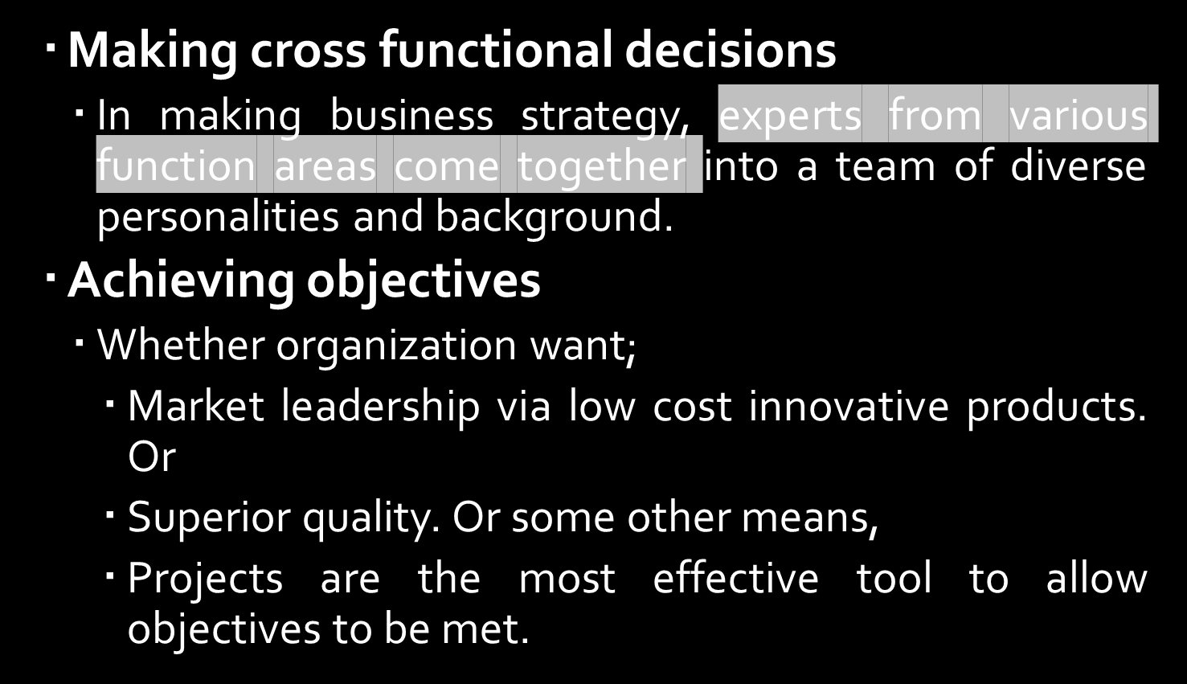
PROJECTS AND ORGANIZATIONAL STRATEGY
Copyright ©2016 Pearson Education, Inc.
2-5

Slide 12
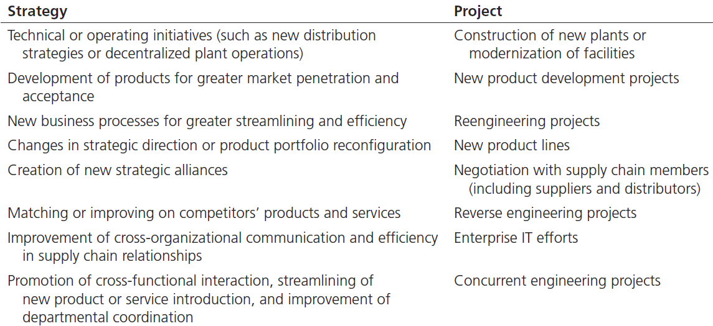
PROJECTS REFLECT STRATEGY
(TABLE 2.1)
Copyright ©2016 Pearson Education, Inc.
2-6

Slide 13
PROJECTS AND ORGANIZATIONAL STRATEGY
The tows matrix (See Figure 2.2) is a useful way to see the links between projects and an organization’s strategic choices. TOWS comes from the acronym for
“Threats–Opportunities–Weaknesses–Strengths”
and refers to the challenges companies face in both their internal environment (within the organization) and their external environment (outside the company).
Copyright ©2016 Pearson Education, Inc.
2-5

Slide 14
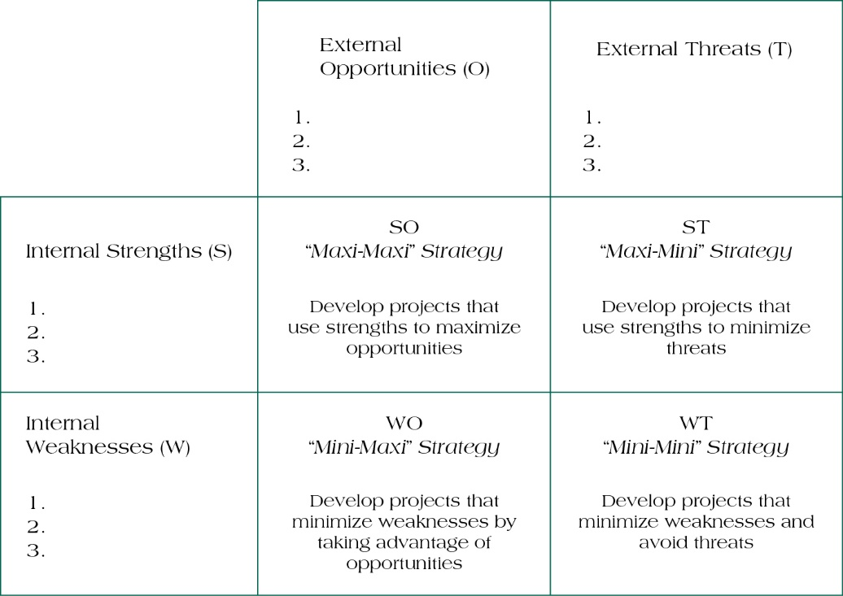
TOWS MATRIX
(FIGURE 2.2)
2-7

Slide 15
STAKEHOLDER MANAGEMENT
Stakeholder Analysis is a useful tool for demonstrating some of the seemingly irresolvable conflicts that occur through the planned creation and introduction of new projects.
Project Stakeholders are defined as all individuals or groups
who have an active stake in the project and can potentially impact, either positively or negatively, its development.
Copyright ©2016 Pearson Education, Inc.
2-8

Slide 16
IDENTIFYING PROJECT STAKEHOLDERS
Internal Stakeholders
Top management
Accountant
Other functional managers
Project team members
External Stakeholders
Clients
Competitors
Suppliers
Environmental, political, consumer, and other intervener groups
Copyright ©2016 Pearson Education, Inc.
2-9

Slide 17
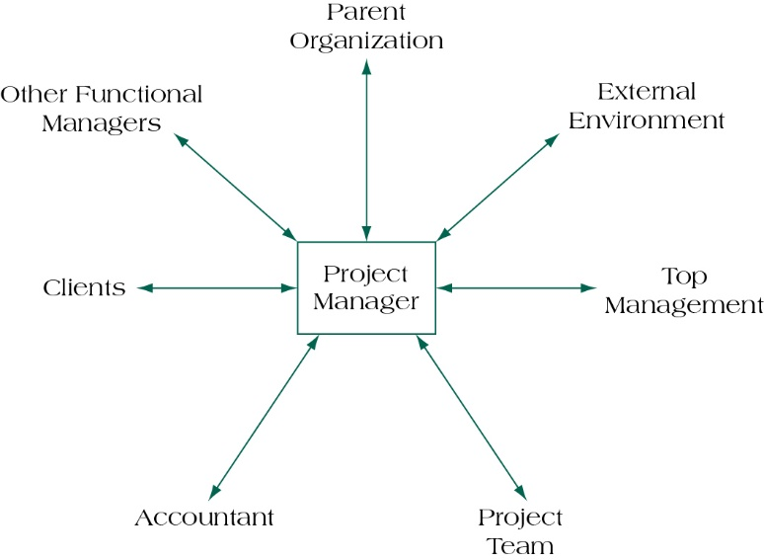
PROJECT STAKEHOLDER RELATIONSHIPS
(FIGURE 2.3)
2-<number>

Slide 18
MANAGING STAKEHOLDERS
Assess the environment.
Identify the goals of the principal actors.
Assess your own capabilities.
Define the problem.
Develop solutions.
Test and refine the solutions.
Copyright ©2016 Pearson Education, Inc.
2-11

Slide 19
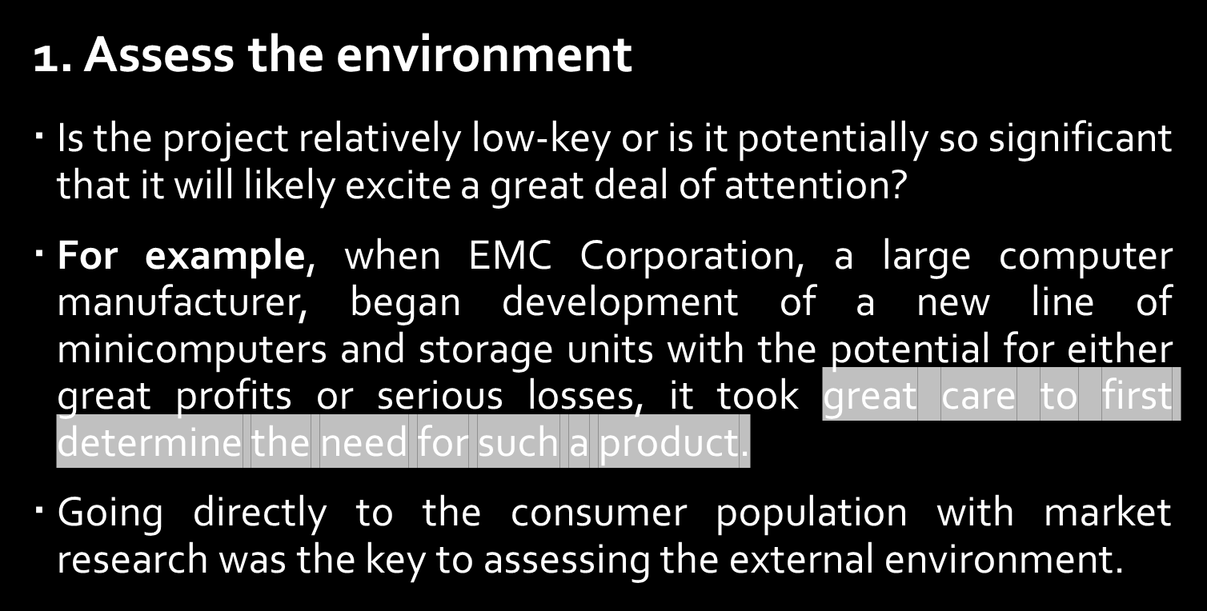
MANAGING STAKEHOLDERS
Copyright ©2016 Pearson Education, Inc.
2-11

Slide 20
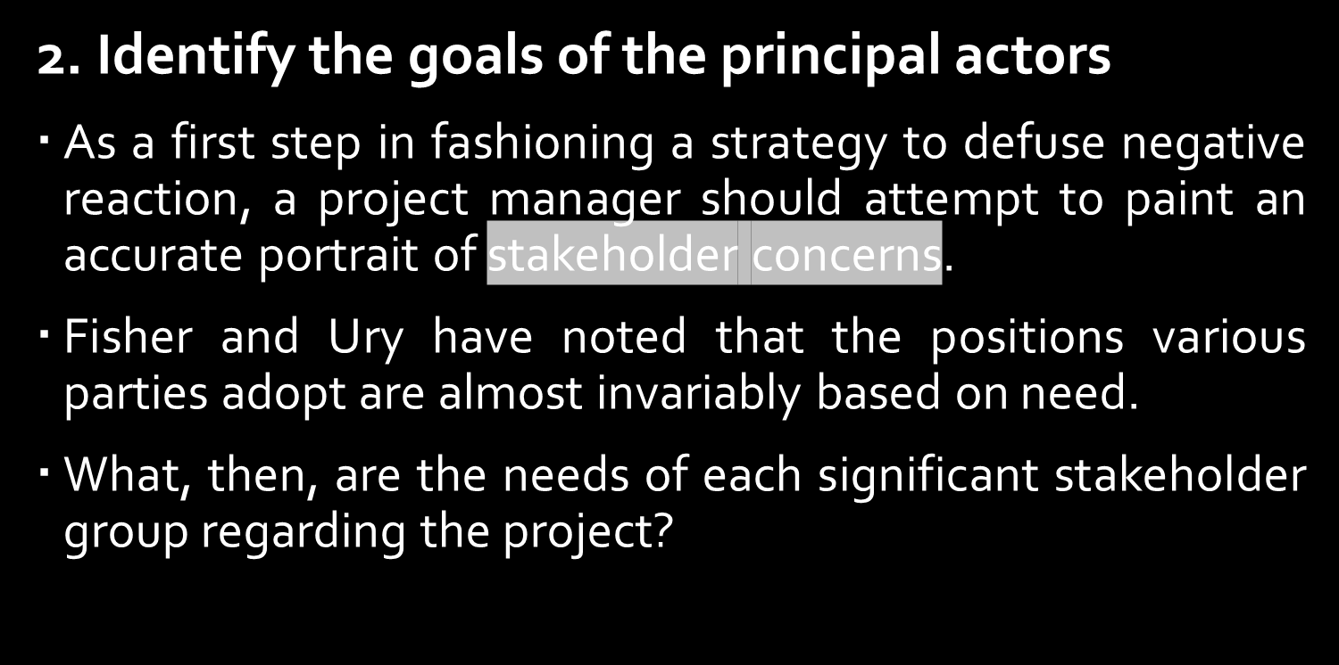
MANAGING STAKEHOLDERS
Copyright ©2016 Pearson Education, Inc.
2-11

Slide 21
MANAGING STAKEHOLDERS
An example will illustrate this point.
A small IT firm specializing in network solutions and software development recently contracted with a larger publishing house to develop a simulation for college classroom use.
The software firm was willing to negotiate a lower-than-normal price for the job because the publisher suggested that excellent performance on this project would lead to future business.
The software organization, interested in follow-up business, accepted the lower fee because its more immediate needs were to gain entry into publishing and develop long-term customer contacts.
The publisher needed a low price; the software developer needed new market opportunities.
Copyright ©2016 Pearson Education, Inc.
2-11

Slide 22

MANAGING STAKEHOLDERS
Copyright ©2016 Pearson Education, Inc.
2-11

Slide 23
MANAGING STAKEHOLDERS
For example, not everyone has the contacts to upper management that may be necessary for ensuring a steady flow of support and resources.
If you realistically determine that political acumen is not your strong suit, then the solution may be to find someone who has these skills to help you.
Copyright ©2016 Pearson Education, Inc.

Slide 24
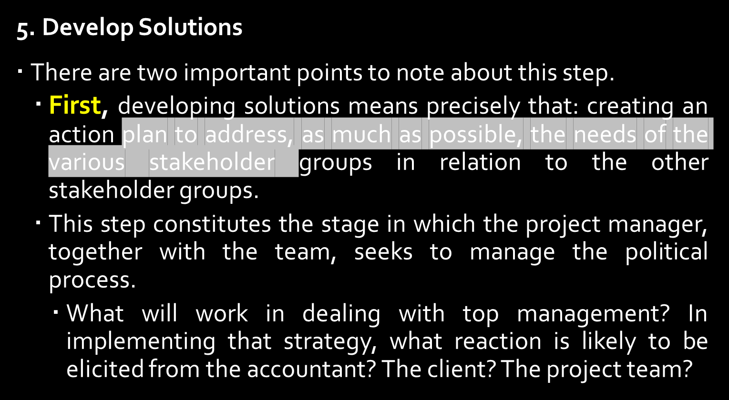
MANAGING STAKEHOLDERS
Copyright ©2016 Pearson Education, Inc.

Slide 25
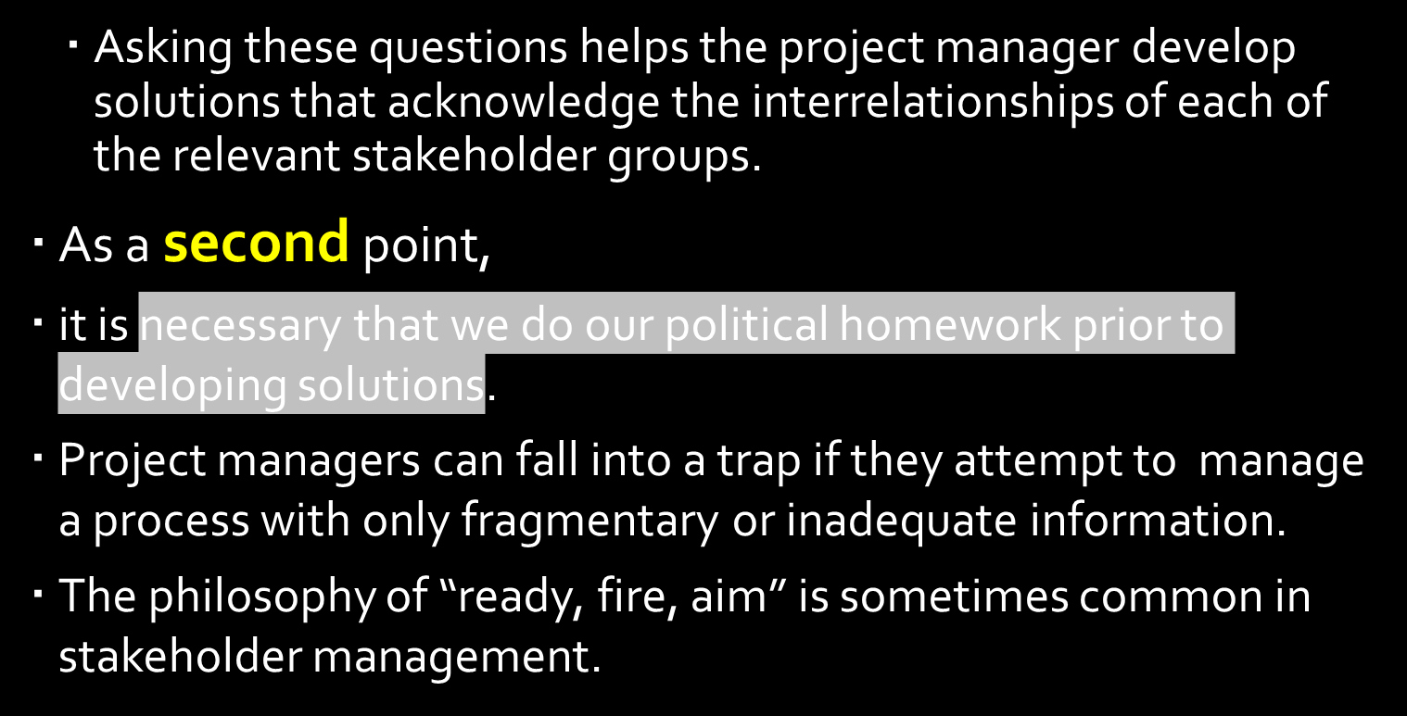
MANAGING STAKEHOLDERS
Copyright ©2016 Pearson Education, Inc.

Slide 26
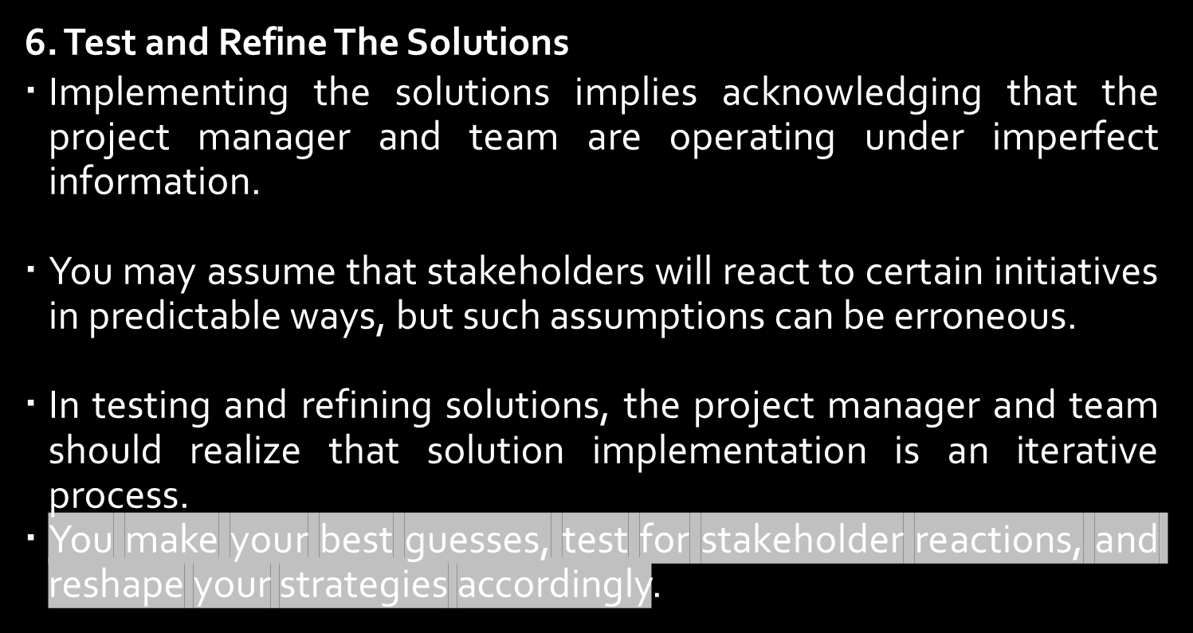
MANAGING STAKEHOLDERS
Copyright ©2016 Pearson Education, Inc.
2-11

Slide 27
ORGANIZATIONAL STRUCTURE
Consists of three key elements:
Designates formal reporting relationships
  number of levels in the hierarchy
  span of control
Identifies groupings of:
  individuals into departments
  departments into the total organization
Design of systems to ensure
  effective communication
  coordination
  integration across departments
Copyright ©2016 Pearson Education, Inc.
2-12

Slide 28
FORMS OF ORGANIZATION STRUCTURE
Functional organizations – group people performing similar activities into departments
Project organizations – group people into project teams on temporary assignments
Matrix organizations – create a dual hierarchy in which functions and projects have equal prominence
Copyright ©2016 Pearson Education, Inc.
2-13

Slide 29
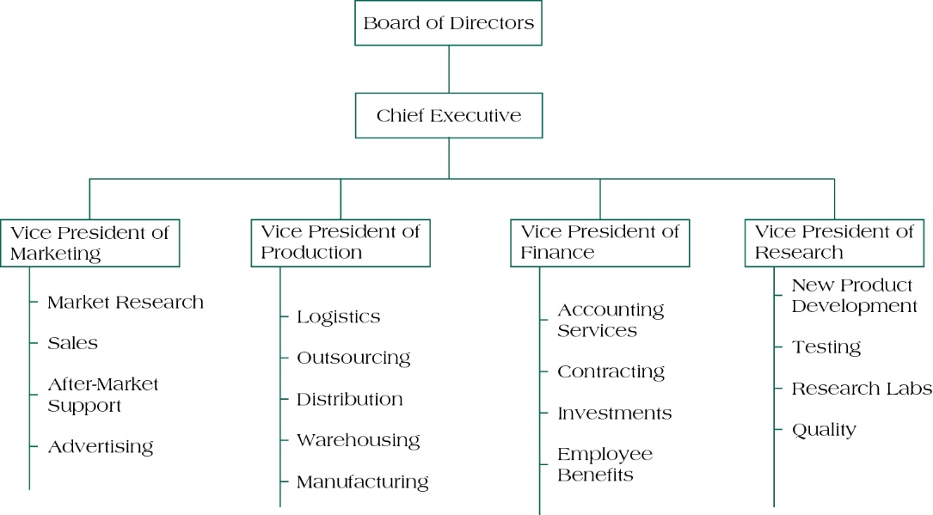
FUNCTIONAL ORGANIZATIONAL STRUCTURE
(FIGURE 2.4)
2-14

Slide 30
FUNCTIONAL STRUCTURES
(TABLE 2.2)
Strengths for Project Management | Weaknesses for Project Management
Projects developed within basic functional structure require no disruption or change to firm’s design. Enables development of in-depth knowledge and intellectual capital. Allows for standard career paths. | Functional siloing makes it difficult to achieve cross-functional cooperation. Lack of customer focus. Longer time to complete projects. Varying interest or commitment.
Copyright ©2016 Pearson Education, Inc.
2-15

Slide 31
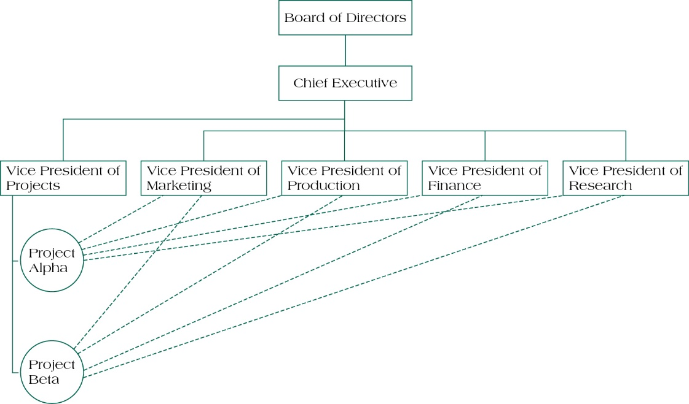
PROJECT ORGANIZATIONAL STRUCTURE EXAMPLE
(FIGURE 2.6)
2-16

Slide 32
PROJECT STRUCTURES
(TABLE 2.3)
Strengths for Project Management | Weaknesses for Project Management
Project manager sole authority Improved communication Effective decision-making Creation of project management experts Rapid response to market opportunities | Expensive to set up and maintain teams Chance of loyalty to the project rather than the firm Difficult to maintain a pooled supply of intellectual capital Team member concern about future once project ends
Copyright ©2016 Pearson Education, Inc.
2-17

Slide 33
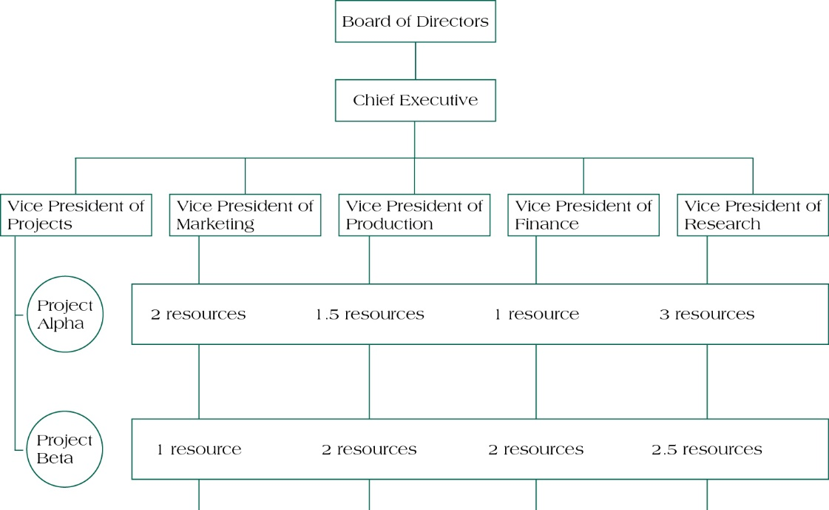
MATRIX ORGANIZATIONAL STRUCTURE
(FIGURE 2.7)
2-18

Slide 34
MATRIX STRUCTURES
(TABLE 2.4)
Strengths for Project Management | Weaknesses for Project Management
Suited to dynamic environments Equal emphasis on project management and functional efficiency Promotes coordination across functional units Maximizes scarce resources | Dual hierarchies mean two bosses Negotiation required in order to share resources Workers caught between competing project & functional demands
Copyright ©2016 Pearson Education, Inc.
2-19

Slide 35
HEAVYWEIGHT PROJECT ORGANIZATIONS
Organizations can sometimes gain tremendous benefit from creating a fully-dedicated project organization.
Lockheed Corporation’s “Skunkworks”
Project manager authority expanded
Functional alignment abandoned in favor of market opportunism
Focus on external customer
Copyright ©2016 Pearson Education, Inc.
2-20

Slide 36
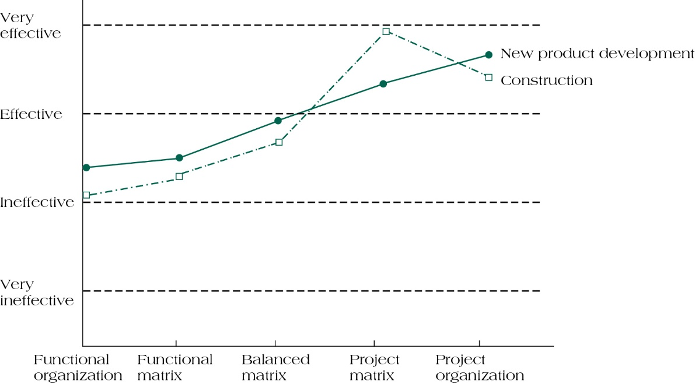
MANAGER’S PERCEPTIONS OF EFFECTIVENESS OF VARIOUS STRUCTURES ON PROJECT SUCCESS
(FIGURE 2.8)
2-21

Slide 37
PROJECT MANAGEMENT OFFICES
Centralized units that oversee or improve the management of projects
Resource centers for:
  Technical details
  Expertise
  Repository
  Center for excellence
Copyright ©2016 Pearson Education, Inc.
2-22

Slide 38
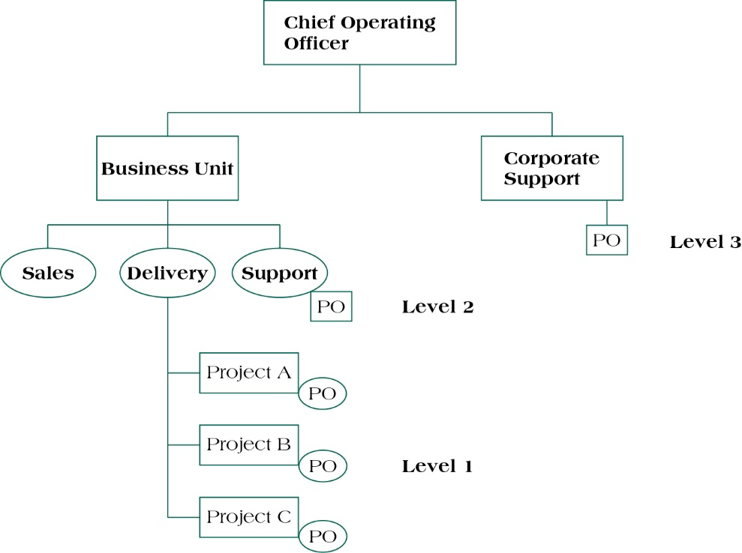
ALTERNATIVE LEVELS OF PROJECT OFFICES
(FIGURE 2.9)
2-23

Slide 39
FORMS OF PMOs
Weather station – monitoring and tracking
Control tower – project management is a skill to be protected and supported
Resource pool – maintain and provide a cadre of skilled project professionals
Copyright ©2016 Pearson Education, Inc.
2-24

Slide 40
PMO CONTROL TOWER
Performs four functions:
  Establishes standards for managing projects
  Consults on how to follow these standards
  Enforces the standards
  Improves the standards
Copyright ©2016 Pearson Education, Inc.
2-25

Slide 41
ORGANIZATIONAL CULTURE
Unwritten
Rules of behavior
Held by some subset of the organization members
Taught to all new members
Copyright ©2016 Pearson Education, Inc.
2-26

Slide 42
KEY FACTORS THAT AFFECT CULTURE DEVELOPMENT
Technology
Environment
Geographical location
Reward systems
Rules and procedures
Key organizational members
Critical incidents
Copyright ©2016 Pearson Education, Inc.
2-27

Slide 43
ORGANIZATIONAL CULTURE
Departmental interaction
  focused on the importance of developing and maintaining a solid, supportive relationship between functional departments and project teams.
Employee commitment to goals
  Projects depend on the commitment and motivation of the personnel assigned to their activities.
Project planning
  will explore the process of activity duration estimation in a later chapter
Performance evaluation
  Supportive cultures encourage project team members taking the initiative, even if it means taking risks to boost performance.
Copyright ©2016 Pearson Education, Inc.
2-28

Slide 44
SUMMARY
Understand how effective project management contributes to achieving strategic objectives.
Recognize three components of the corporate strategy model: formulation, implementation, and evaluation.
See the importance of identifying critical project stakeholders and managing them within the context of project development.
Recognize the strengths and weaknesses of three basic forms of organizational structure and their implications for managing projects.
Copyright ©2016 Pearson Education, Inc.
2-29

Slide 45
SUMMARY
Understand how companies can change their structure into a “heavyweight project organization” structure to facilitate effective project management practices.
Identify the characteristics of three forms of project management office (PMO).
Understand key concepts of corporate culture and how cultures are formed.
Recognize the positive effects of a supportive organizational culture on project management practices versus those of a culture that works against project management.
2-30

Slide 46

Copyright ©2016 Pearson Education, Inc.
2-<number>

